Slide 1

POWERPOINT SLIDE TEMPLATES for
OPTION 1 (CURRICULUM MODULES)
Notes:
See the “Notes” for comments on the following slides.

Slide 2
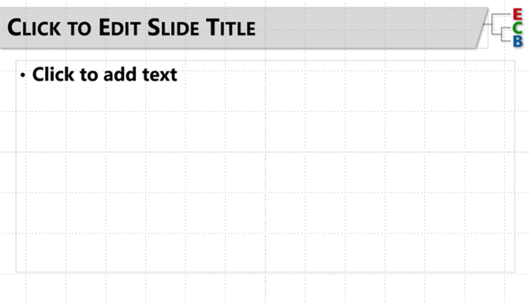
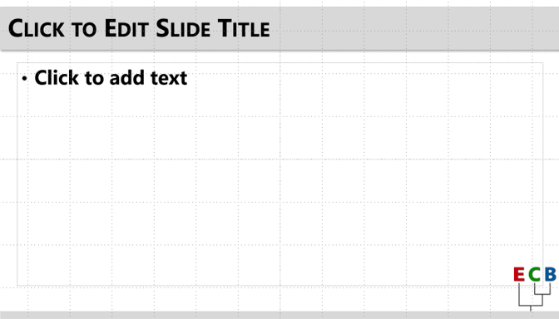
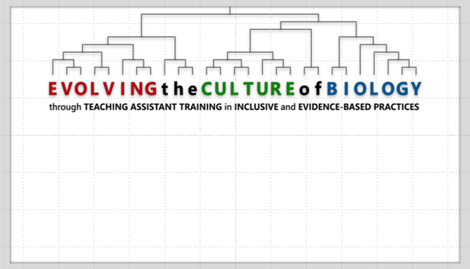
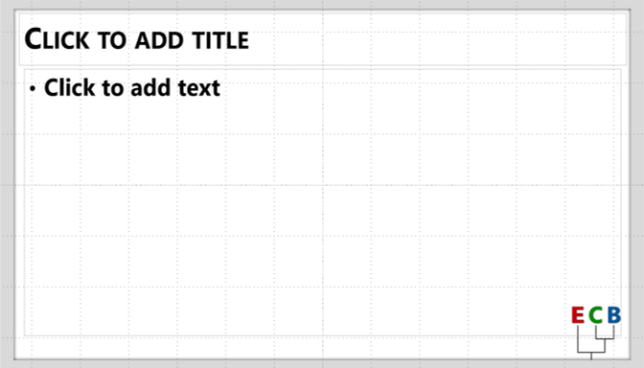
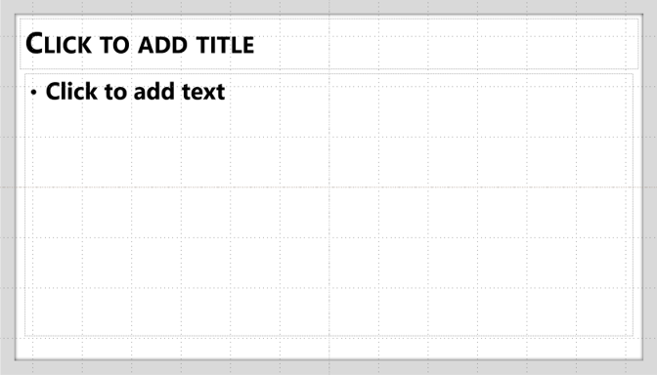
How to Use the Template File (1)
This file is built using the “Slide Master” feature of Powerpoint. When you create new slides, it will assign a “layout” from those built into the Master.
Thus, to change the style and background images, you can change the layout on slides as you create or modify them (see here for a guide for your system).
There are five main layouts for you to use, each shown below with its name:
Main
Header
Alt
Header
Frame w/
Full Logo
Frame w/
Small Logo
Frame
Blank
Notes:
Information for ECB Scholars and other TPD Catalyst authors

Slide 3
How to Use the Template File (2)
The purpose of creating a theme is so that materials shared in the TPD Catalyst can be cohesive in look and feel for eventual repository users.
That said, these are your instructional materials that you will be sharing with the community through the TPD Catalyst (with your permission). The layouts are intentionally minimalist, however, to allow for flexibility in how you want your instructional materials to look.
A few key considerations:
  Main Font: Segoe UI (others are acceptable but please maintain aesthetic consistency)
  Main ECB Colors: RED (#C0000C), GREEN (#008A00), BLUE (#005699)
  Citations: Remember that this is a “publication” of sorts that will be shared with the scientific education community. Please have the necessary permissions to use any content or images, and appropriately cite any materials you did not personally create.
  Notes: Use presenter notes (guide) for facilitator notes (as required of TPD Catalyst modules).
Notes:
Information for ECB Scholars and other TPD Catalyst authors

Slide 4
SEE EXAMPLE TEMPLATE LAYOUTS ON THE
FOLLOWING SLIDES
Notes:
Template Layout Examples.
See Microsoft guides for help assigning a layout to slides if needed (a few very simple steps):
https://support.microsoft.com/en-au/office/apply-a-slide-layout-158e6dba-e53e-479b-a6fc-caab72609689

Slide 5
“MAIN HEADER”
Notes:
The “Main Header” layout for most content

Slide 6
“ALT HEADER”
Notes:
The “Alt Header” layout for main content

Slide 7
“FRAME w/ FULL LOGO”
Notes:
The “Frame w/ Full Logo” (e.g., for title slides, section breaks, and other general uses)

Slide 8
“FRAME w/ SMALL LOGO”
Notes:
The “Frame w/ Small Logo” for general content, with ample white space for flexibility (and a subtle ECB logo in the corner)

Slide 9
“FRAME BLANK”
Notes:
The “Frame Blank” layout for general content, with maximum white space and flexibility (and no ECB logo)

